Slide 1

University of North Texas
CSCE 2110
Foundations of Data Structures
Splay Tree

Slide 2
Contents
Splay tree
insertion
find
deletion

Slide 3
Contents
Splay tree
insertion
find
deletion
running time analysis Binary Trees

Slide 4
Self adjusting Trees
Ordinary binary search trees have no balance conditions
What you get from insertion order is it
Balanced trees like AVL trees enforce a balance condition when nodes change
Tree is always balanced after an insert or delete
Self-adjusting trees get reorganized over time as nodes are accessed
Tree adjusts after insert, delete, or find

Slide 5
Splay Trees
Splay trees are tree structures that:
Are not perfectly balanced all the time
Data most recently accessed is near the root. (principle of locality; 80-20 “rule”)
The procedure:
After node X is accessed, perform “splaying” operations to bring X to the root of the tree.
Do this in a way that leaves the tree more balanced as a whole

Slide 6
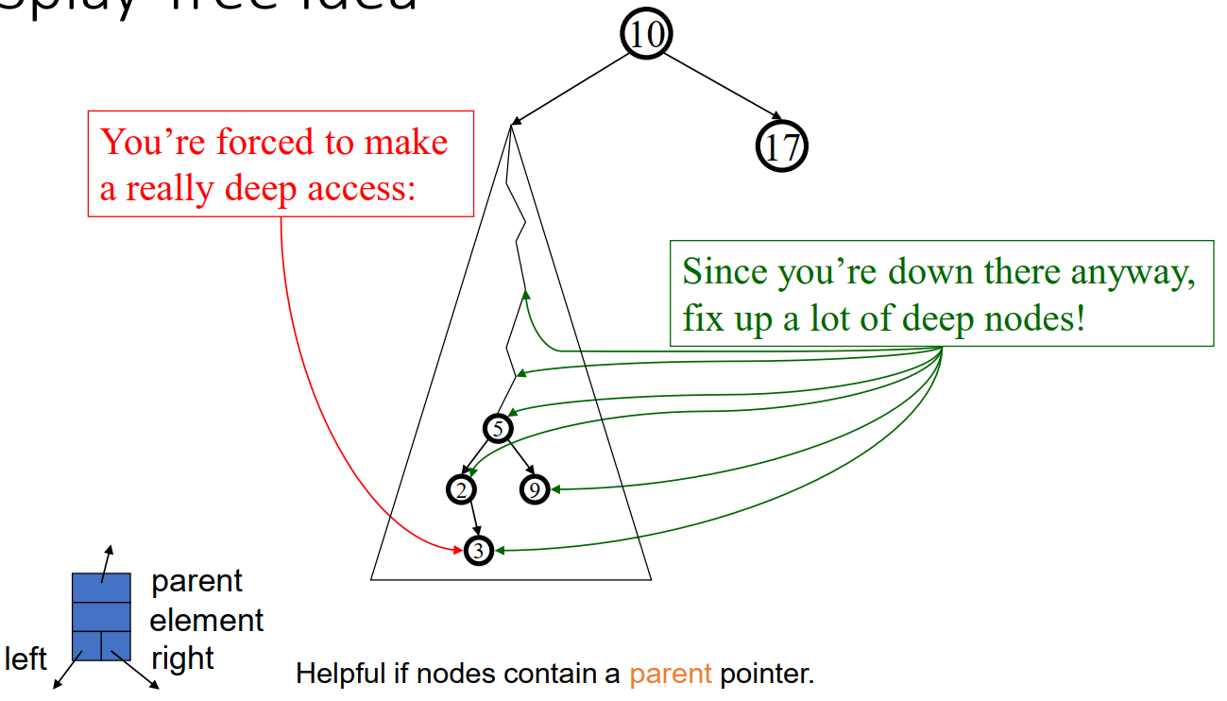
Splay Tree Idea

Slide 7
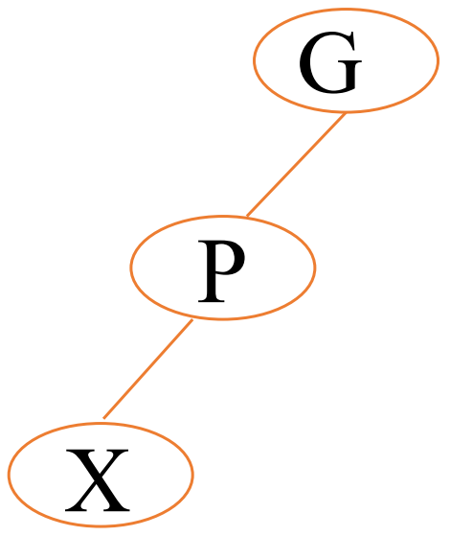
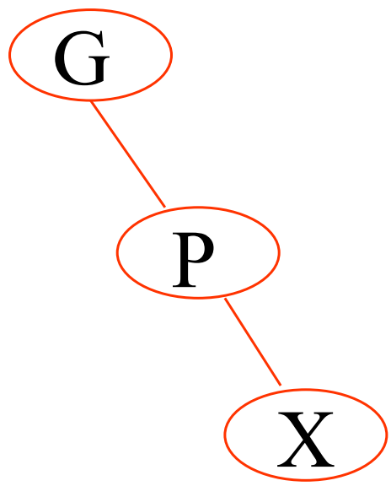
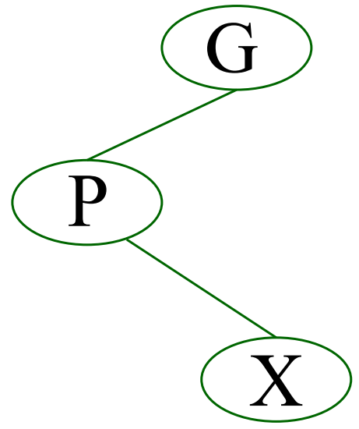
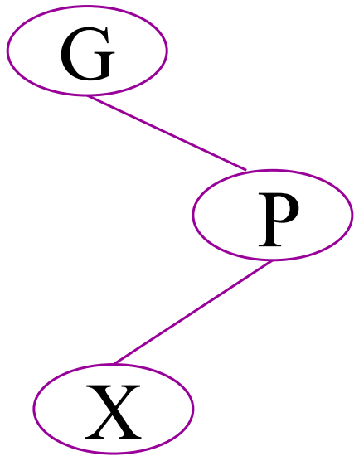
Splaying Cases
Node being accessed (x) is:
Root
Child of root
Has both parent (p) and grandparent (g)
Zig-zig pattern: g → p → x is left-left or right-right
Zig-zag pattern: g → p → x is left-right or right-left

Slide 8
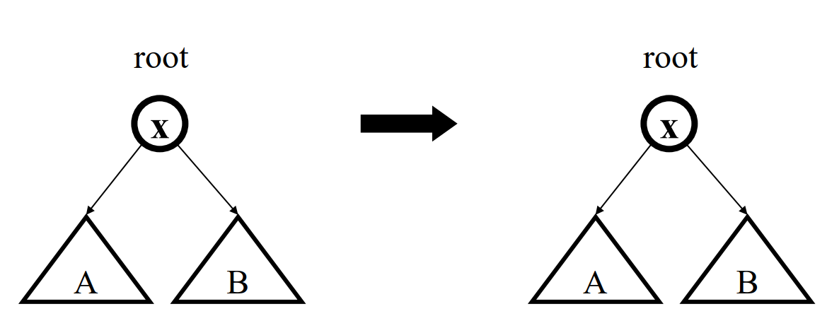
Access Root
Do nothing (that was easy!)

Slide 9
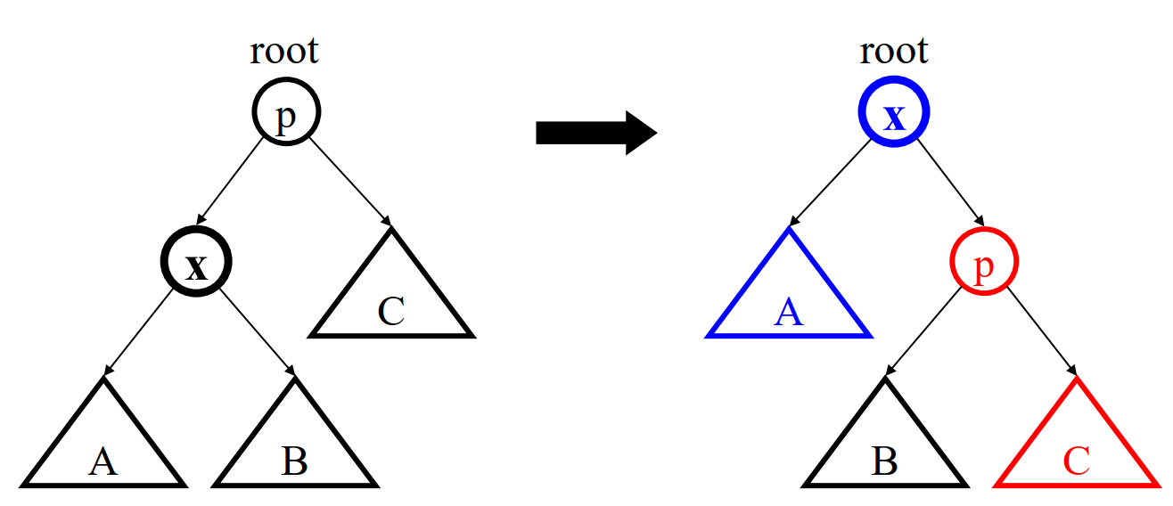
Access Child of Root
Zig (AVL single rotation)

Slide 10
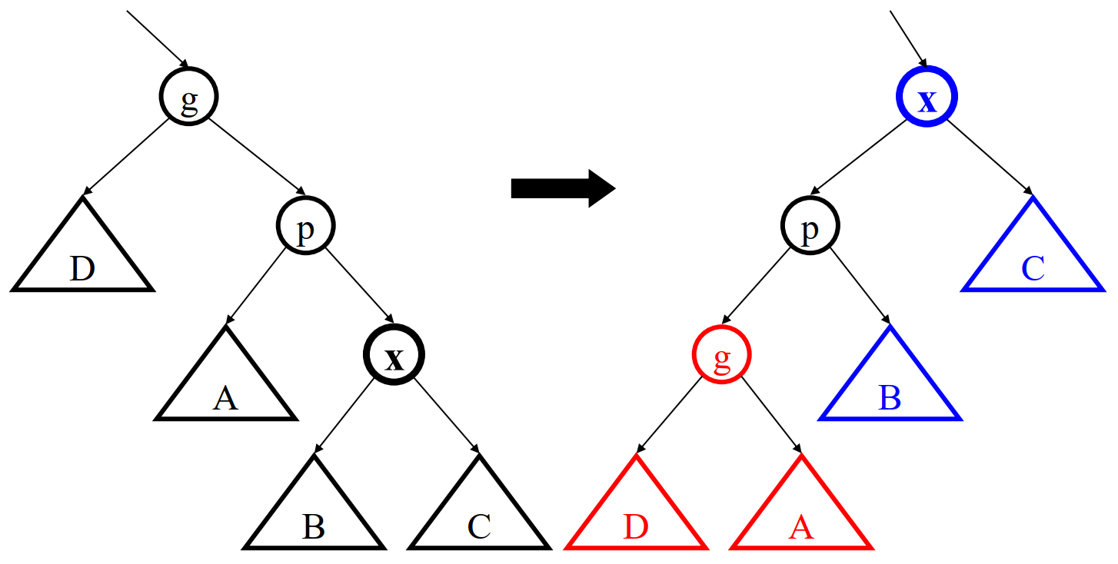
Access (LL, RR) Grandchild
Zig-Zag

Slide 11
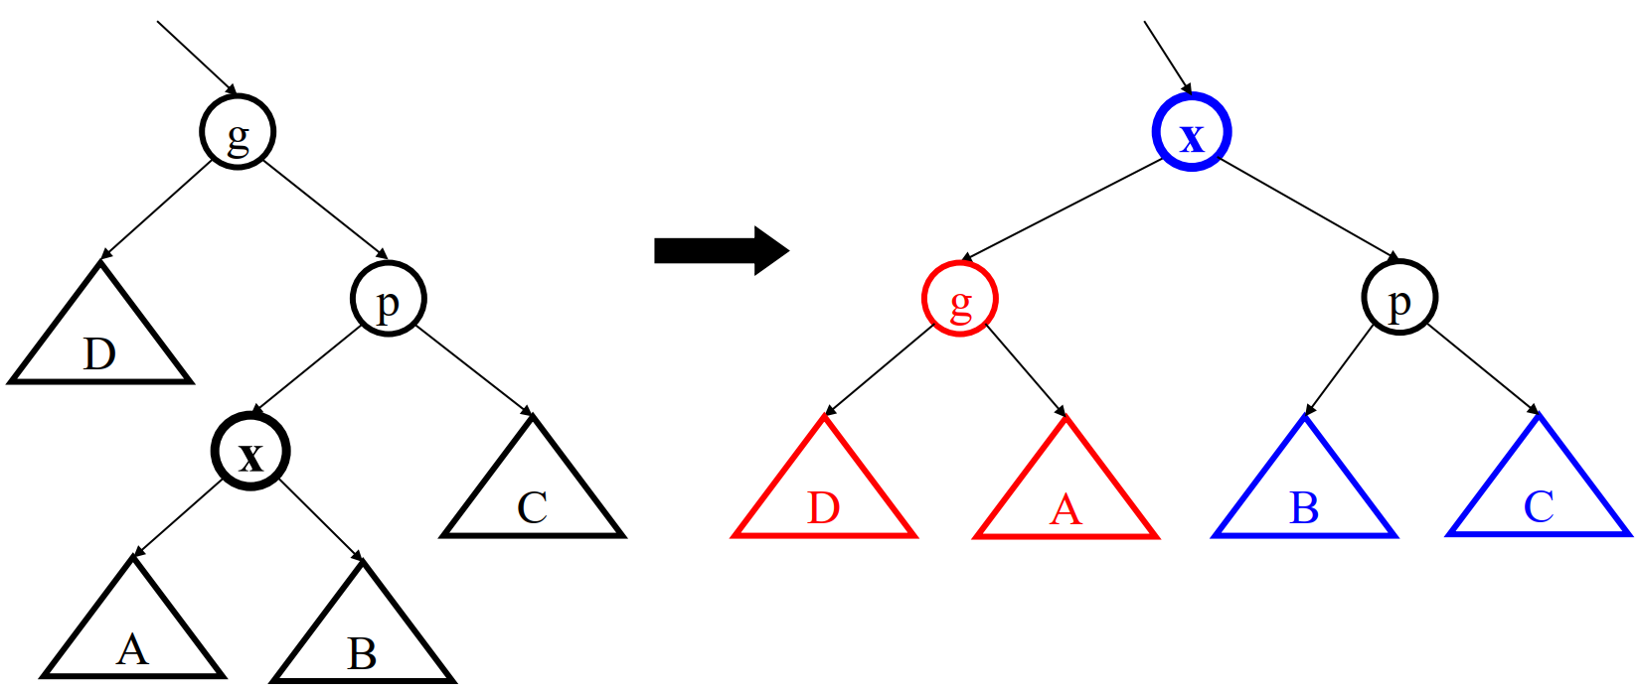
Access (LR, RL) Grandchild
Zig-Zag

Slide 12
Splay Operations: Find
Find the node in normal BST manner
Splay the node to the root Are not perfectly balanced all the time

Slide 13
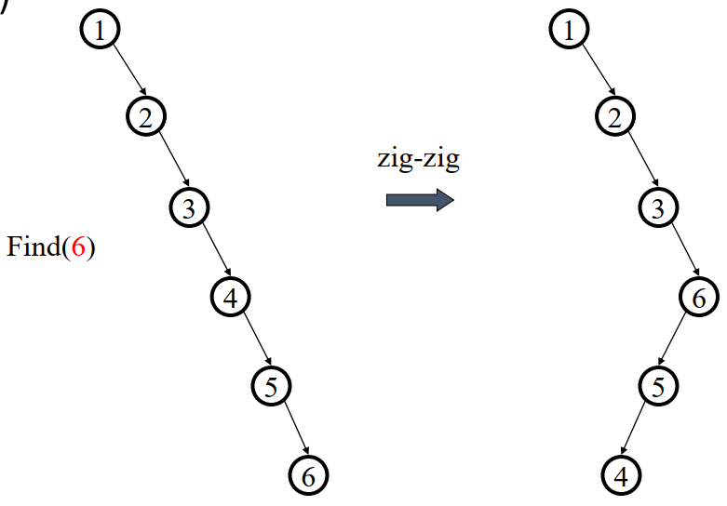
Splaying Example
Find(6)

Slide 14
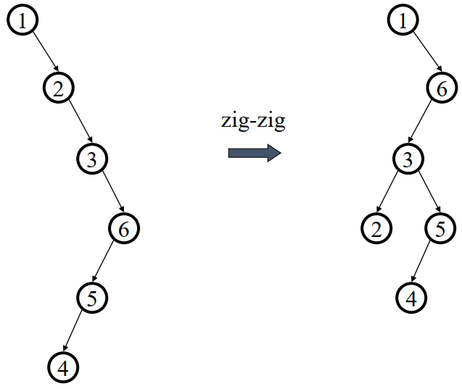
Splaying Example
… still splaying …

Slide 15
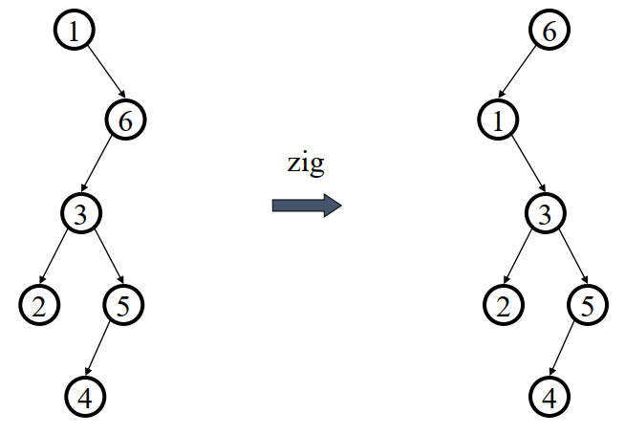
Splaying Example
… 6 splayed out!

Slide 16
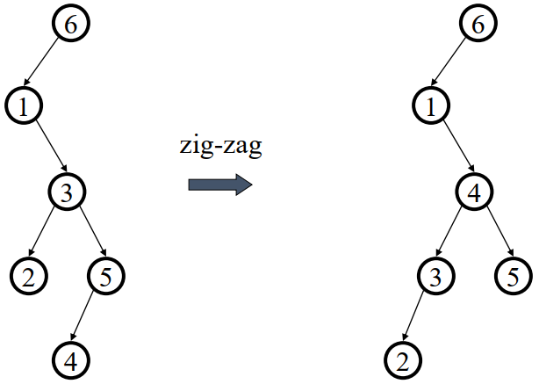
Splaying Example
Find (4)
Splay it Again!

Slide 17
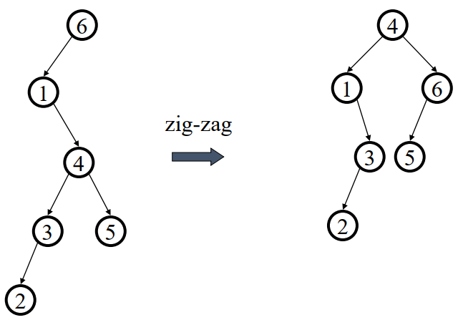
Splaying Example
… 4 splayed out!

Slide 18
Analyzing Calls to a Data Structure
Some algorithms involve repeated calls to one or more data structures
Example:
repeatedly insert keys into a dynamic array
repeatedly remove the smallest key from the heap
When analyzing the running time of the overall algorithm, need to sum up the time spent in all the calls to the data structure
When different calls take different times, how can we accurately calculate the total time?

Slide 19
Amortized Analysis
Purpose is to accurately compute the total time spent in executing a sequence of operations on a data structure
Three different approaches:
aggregate method: brute force
accounting method: assign costs to each operation so that it is easy to sum them up while still ensuring that result is accurate
potential method: a more sophisticated version of the accounting method
In Amortized Analysis, we analyze a sequence of operations and guarantee a worst-case average time which is lower than the worst- case time of a particular expensive operation.

Slide 20
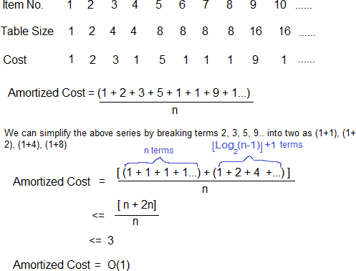
Dynamic Array Insertion

Slide 21
Splay Tree Algorithm Analysis
Worst case time is O(n)
Amortized time for all operations is O(log n)
a sequence of M operations on an n-node splay tree takes O(M log n) time.
Maybe not now, but soon, and for the rest of the operations

Slide 22
Why Splaying Helps
If a node on the access path is at depth 𝑑 before the splay, it’s final depth ≤ 3 + 𝑑/2
Exceptions are the root, the child of the root, and the node splayed
Overall, nodes which are below nodes on the access path tend to move closer to the root

Slide 23
Splay Tree Insert and Delete
Insert x
Insert x as normal then splay x to root.
Delete x
Find x
Splay x to root and remove it
Splay the max in the left subtree to the root
Attach the right subtree to the new root of the left subtree.

Slide 24
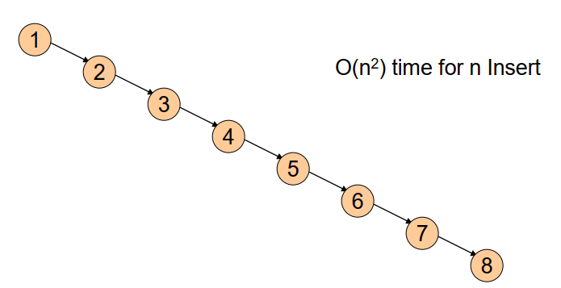
Example Insert
Inserting in order 1, 2, 3, …, 8
Without self-adjustment

Slide 25
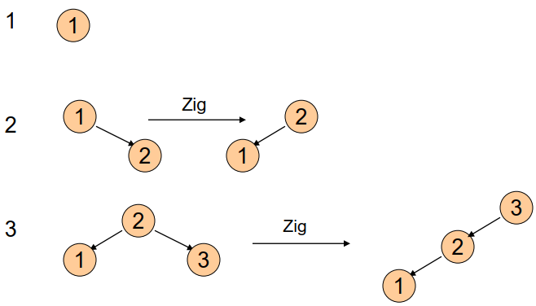
With Self-Adjustment

Slide 26
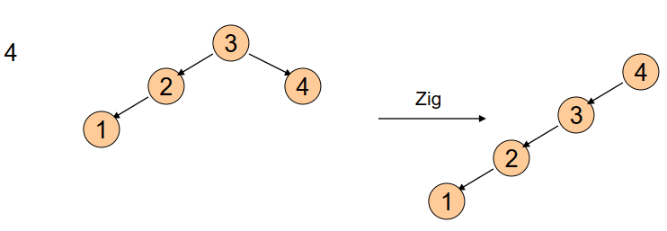
With Self-Adjustment
Each Insert takes O(1) time therefore O(n) time for n Insert!!

Slide 27
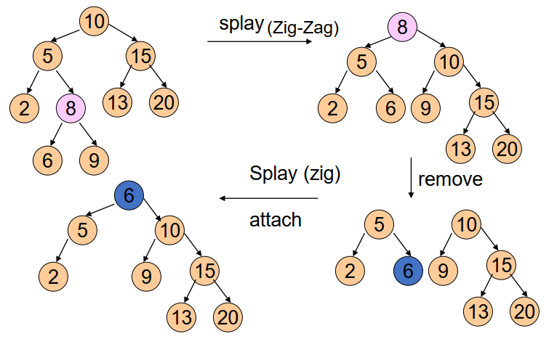
Example Deletion

Slide 28
Summary of Search Trees
Problem with Binary Search Trees: Must keep tree balanced to allow fast access to stored items
AVL trees: Insert/Delete operations keep tree balanced
Splay trees: Repeated Find operations produce balanced trees
Splay trees are very effective search trees
relatively simple: no extra fields required
excellent locality properties:
frequently accessed keys are cheap to find (near top of tree)
infrequently accessed keys stay out of the way (near bottom of tree)

